Slide 1







Presented by :
# sg_ connecting_ the dots with ML

Slide 2

THE TEAM
J I N E S H M A L O O | TEAM L E A D
Machine Learning enthusiast by heart and a Data Science evangelist by profession. Currently associated with TCS Japan as Jr. Data Scientist, overall 4.8yrs of IT experience
A D I T YA L A H A R I YA
Currently working in TCS as a software Engineer
A AY U S H I B H A T I Y A
Automation Engineer working in automotive domain with keen interest in Machine Learning
M O H A M M E D AZEEM
Mechanical Engineer | Worked as graduate trainee in maintenance dept. at Toyota Engine manufacturing plant, Bengaluru India
V I K A S Y A D A V
EC Engineer | Working in TCS as Cyber Security Analyst
K A V Y A S H R E E
Trainee engineer in wibmo ,mainly working on payment transactions focused full stack developer.
M A N A S V I T R I V E D I
3rd Year B.Tech Data Science student, a complete newbie and appropriately confused.

Slide 3




Industrial Workflow
We Should Use Data Science To Increase Customer Service
How Does Your ML Algorithm Works
If Someone Provides Me Machine Data , sensor Data I will Build Model to Predict Machine Failure
Is this Reliable ? I have New data CAn that Be inculded in Evaluation

Slide 4

Agenda
What Are Type of Maintenance?
How Does Predictive Maintenance Work? Use Cases for PM
Objective
Workflow Challenges Faced

Slide 5

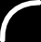

Types of Maintenance
MAINTENANCE
REACTIVE
PROACTIVE
FAILURE BASED
PREVENTIVE AGE BASED
PREDICTIVE CONDITION BASED
Too Late
Too Early
On Time

Slide 6
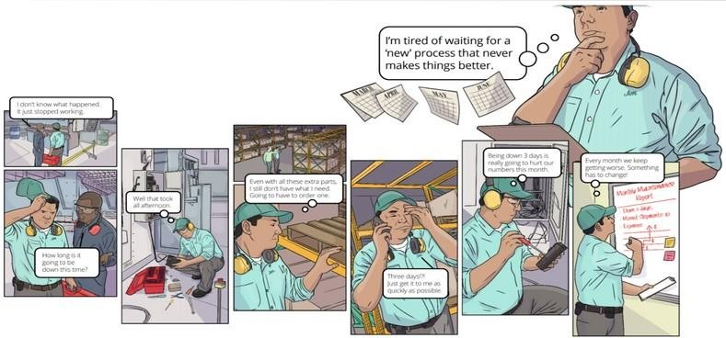
Reactive Maintenance
Reactive maintenance (also known as breakdown maintenance) refers to repairs that are done when equipment has already broken down, in order to restore the equipment to its normal operating condition.

Slide 7
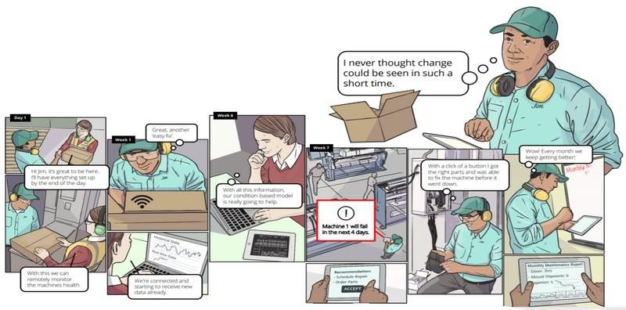
Predictive Maintenance
Predictive maintenance is a proactive maintenance strategy that tries to predict when a piece of equipment might fail so that maintenance work can be performed just before that happens.

Slide 8


Goal
The goal of predictive maintenance is to optimize the balance between corrective and preventative maintenance, by enabling just in time replacement of components. This approach only replaces those components when they are close to
a failure.
DOWNTIME

Slide 9
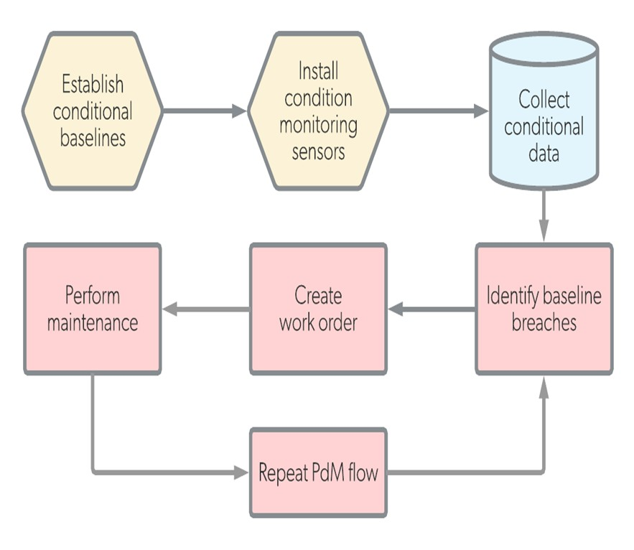
1. Establish baselines
The maintenance team establishes acceptable condition limits for assets that will have sensors.
HOW DOES PREDICTIVE MAINTENANCE WORK
2. Install Internet of Things (IoT) devices The relevant sensor is affixed to the asset. For instance, a vibration meter is affixed to a mechanical asset with gears and a temperature sensor is attached to a boiler.
3. Connect devices to software
The IoT device is connected to remote dashboard where data is collected and analyzed.
4. Schedule maintenance
Inspections are automatically triggered by a CMMS when the condition limit is exceeded or the person monitoring the dashboard schedules the inspection manually.

Slide 10
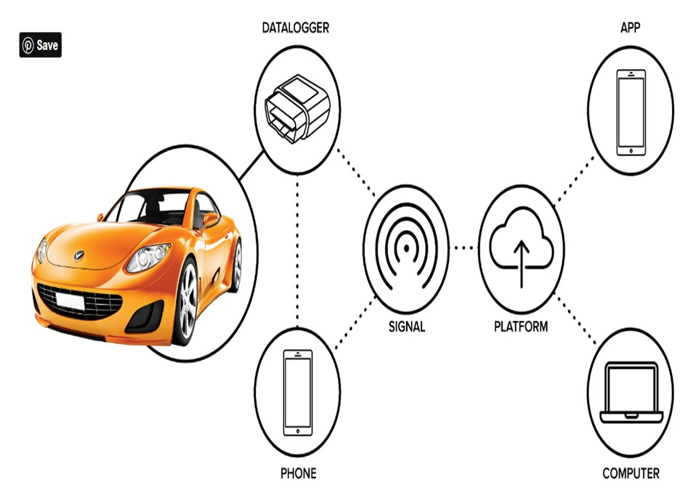
HOW DOES PREDICTIVE MAINTENANCE WORK
For example, vehicle system data is shared with a consumer’s service center, it could allow for timely service or maintenance reminders that are customized for the user’s vehicle profile. On the service station side, technicians could periodically pull data from customers’ vehicles to perform predictive analysis and reach out to customers to schedule service appointments if needed.
Push notification alerts could also delivered onboard via dash screens or to mobile devices.

Slide 11


Use Cases For PM
Any predictive maintenance use case begin with understanding the business problem and defining the objective. Following are some of the common questions which are asked in Predictive Maintenance—
What failure could occur within next 24 hours for my vehicle?
What is the remaining useful life (RUL) of a vehicle’s component?
What are the causes of failure of my vehicle and what action should be taken to fix it?

Slide 12
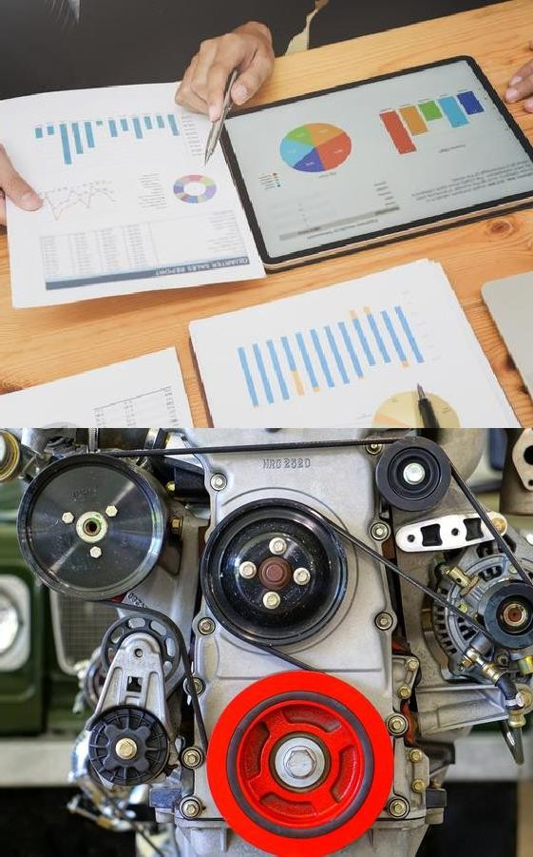
OBJECTIVE
To train a Machine Learning model to predict the probability that a machine will fail 24 hours prior to the breakdown, due to a certain component failure (component 1, 2, 3, or 4)

Slide 13


Slide 14

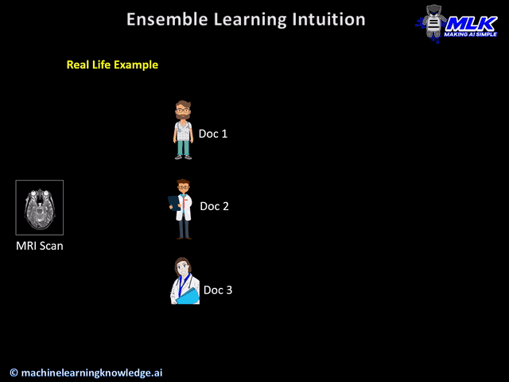

Slide 15
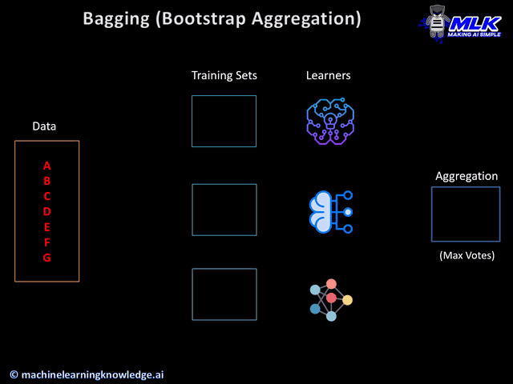

Slide 16
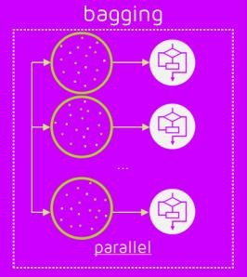
Bagging
Here the objective is to create several subsets of data from training sample chosen randomly with replacement. Each collection of subset data is used to train their decision trees.
STEPS
Suppose there are N observations and M features in training data set. A sample from training data set is taken randomly with replacement.
A subset of M features are selected randomly and whichever feature gives
the best split is used to split the node iteratively.
The tree is grown to the largest.
Above steps are repeated n times and prediction is given based on the aggregation of predictions from n number of trees.
ADVANTAGES
Reduces over-fitting of the model.
Handles higher dimensionality data very well.
Maintains accuracy for missing data.
Model can experience bias when the proper procedure is ignored.
Bagging can be computationally expensive and this may discourage its use in certain instances.
DISADVANTAGES

Slide 17
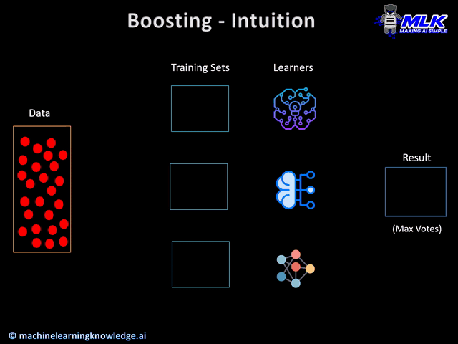

Slide 18
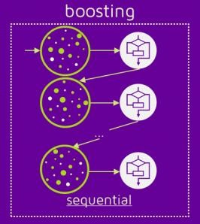
Boosting
In this technique, learners are learned sequentially with early learners fitting simple models to the data and then analysing data for errors. Consecutive trees (random sample) are fit and at every step, the goal is to improve the accuracy from the prior tree.
STEPS
Draw a random subset of training samples d1 without replacement from the training set D to train a weak learner C1
Draw second random training subset d2 without replacement
from the training set and add 50 percent of the samples that were previously falsely classified/misclassified to train a weak learner C2
Find the training samples d3 in the training set D on which C1
and C2 disagree to train a third weak learner C3
Combine all the weak learners via majority voting.
ADVANTAGES
Supports different loss function.
Works well with interactions.
DISADVANTAGES
Prone to over-fitting.
Sensitive to extreme values and noises
Requires careful hyper-parameter tuning

Slide 19





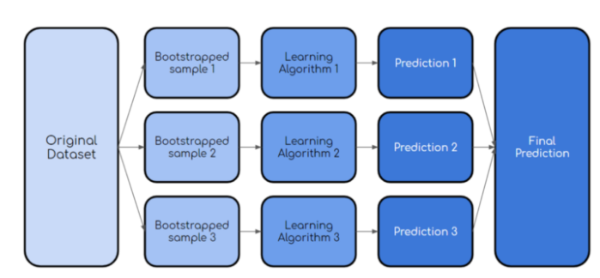
Random Forest
A decision tree is the building block helps to reduce the amount of overfitting.
two key concepts that gives it the name Random:
Random sampling of training data points when building trees.
Random subsets of features considered when splitting nodes
Bootstrap
Aggregation
What do we need in order for our random forest to make accurate class predictions?
We need features that have at least some predictive power. After all, if we put garbage in then we will get garbage out.
The trees of the forest and more importantly their predictions need to be uncorrelated (or at least have low correlations with each other).
Advantages :
Can handle high dimensionality.
Judge importance of features also, interaction.
Not easy to overfit
Faster training speed, easy to make parallel method.
Simple to implement
For unbalanced data set it balances the error.
If large part of the features are lost, accuracy still can be maintained.
Disadvantages:
It is shown to fit over certain noisy classification or regression problems.
As the number of trees increases the complexity also increases.
More computational power needed for more trees.
Longer training periods.

Slide 20
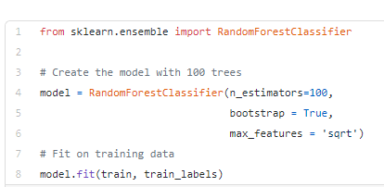
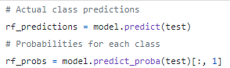
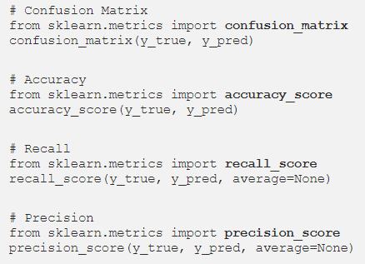
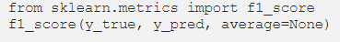
Random Forest
Code
n_estimator - It is the number of trees, Increase for slower performance & better results | usually higher number is used for stability
bootstrap = True - method for sampling data points (with or without replacement
max_feature = ‘sqrt’ | ‘auto’ - max number of features considered for splitting a node
max_depth = max number of levels in each decision tree
min_samples_split = min number of data points placed in a node before the node is split
min_samples_leaf = min number of data points allowed in a leaf node
For predicting the values from the test data set
Performance measures

Slide 21
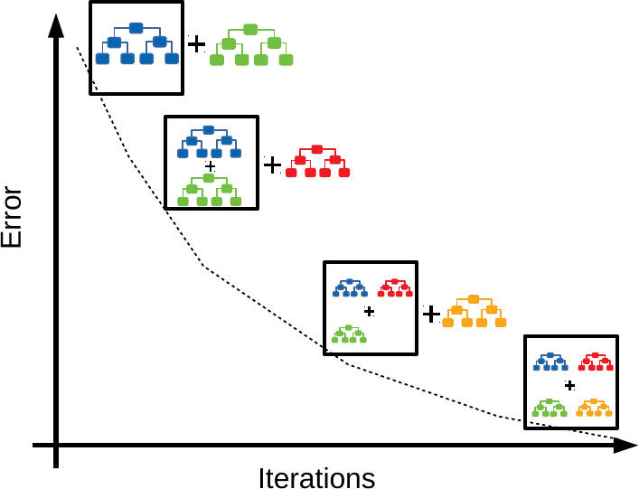
Gradient Boosting
Boosting is an ensemble tree method that builds consecutive small trees with each tree focused on correcting the net error fromthe previous tree.
Gradient boosting is the most popular extension of boosting, and uses the gradient descent algorithm for optimization.

Slide 22
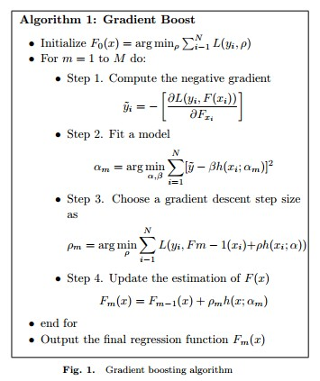
Gradient Boosting Explained
Gradient boosting involves three elements:
A loss function to be optimized.
A weak learner to make predictions.
An additive model to add weak learners to minimize the loss function.
Improvements to Basic Gradient Boosting
Gradient boosting is a greedy algorithm and can overfit a training dataset quickly, thus we look at 4 enhancements to basic gradient boosting which help avoid this:
Tree Constraints
Shrinkage
Random sampling

Slide 23
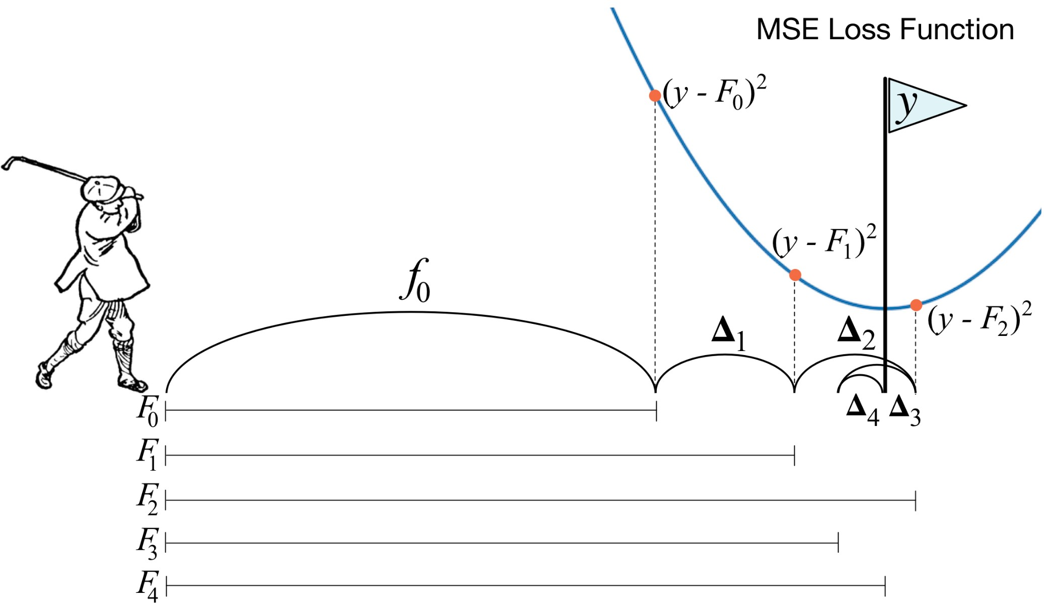
Gradient Boosting Explained
Advantages:
They are powerful and accurate, in many cases even more so than random forest
Good at handling complex, non-linear relationships
They are good at dealing with imbalanced data
Disadvantages:
Slower to train, since trees must be built sequentially
Prone to overfitting if the data is noisy
Harder to tune hyperparameters

Slide 24


Slide 25
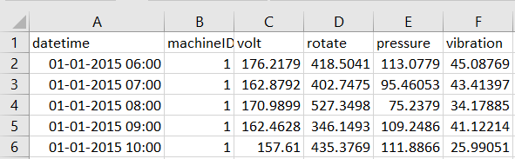
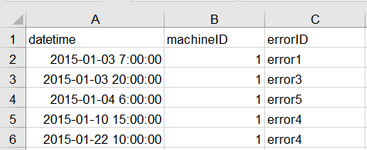
Data Description
Dataset 1
MACHINE CONDITIONS AND USAGE
The operating conditions of a machine
e.g. data collected from sensors. The data is expected to contain time- varying features that capture this aging pattern, and any anomalies that leads to degradation.
Dataset 2
ERROR HISTORY
These are non-breaking errors thrown while the machine is still operational and do not constitute as failures.

Slide 26
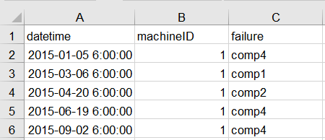
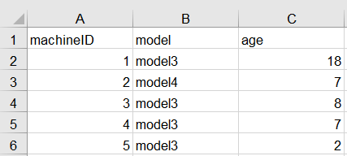
Data Description
Dataset 3
FAILURE HISTORY
The failure history of a machine or component
within the machine.
Dataset 4
MACHINE FEATURES
The features of a machine, e.g. engine size, make and model, location.

Slide 27
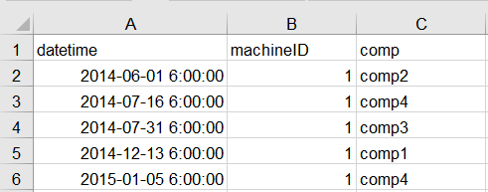
Data Description
Dataset 5
MAINTENANCE HISTORY
These are the scheduled and unscheduled maintenance records which correspond to both regular inspection of components as well as failures. A record is generated if a component is replaced during the scheduled inspection or replaced due to a breakdown.

Slide 28
Data visualization----Done in Tableau

Slide 29
Preprocessing Steps
Data Collection
Formating Data
Feature Engineering
Combining The Datasets
Labelling the Data
Spliting into Train& Test
Model Building

Slide 30
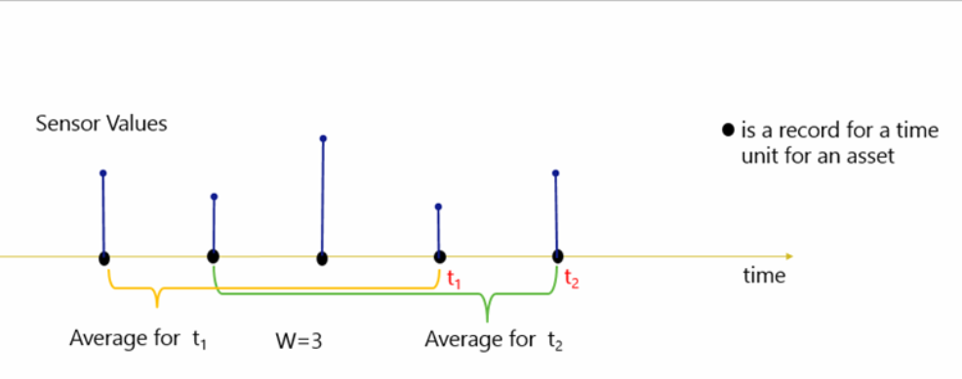
Rolling Aggregates
Aggregation and Feature Engineering
Iot data in itself is very granular if captured per second. There could be very subtle or no difference between data points at successive levels at such granularity. Hence to derive valuable information from the data, it would first need to be aggregated to capture the patterns.
For each record of an asset, a rolling window of size "W" is chosen as the number of units of time to compute the aggregates. Lag features are then computed using the W periods before the date of that recordent

Slide 31
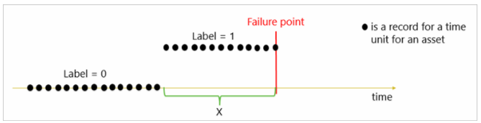
Label Classifiaction
In order to create a predictive model to answer the question "What is the probability that the asset fails in the next X units of time?", labeling is done by taking X records prior to the failure of an asset and labeling them as "about to fail" (label = 1) while labeling all other records as "normal" (label =0). In this method, labels are categorical variables and our Comp
The definition of X is generally dependent upon business requirement and rules.

Slide 32
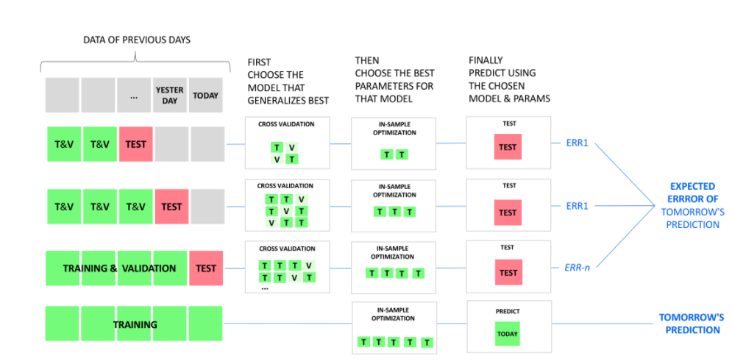
Training, validation, and testing methods for predictive maintenance
In PdM problems, data is recorded as a time series of events that come from several data sources. These records may be ordered according to the time of labeling. Hence, if the dataset is split randomly into training and validation set, some of the training examples may be later in time than some of validation examples. Future performance of hyperparameter values will be estimated based on some data that arrived before model was trained. These estimations might be overly optimistic
The recommended way is to split the examples into training and validation set in a time-dependent manner, where all validation examples are later in time than all training examples. For each set of hyperparameter values, train the algorithm over the training data set. Measure the model's performance over the same validation set. Choose hyperparameter values that show the best performance.

Slide 33
Evaluation Metrics
Many PdM problems face such imbalanced datasets, where one class is severely underrepresented compared to the other class, or classes. In some situations, the minority class may constitute only 0.001% of the total data points
With class imbalance in data, performance of most standard learning algorithms is compromised, since they aim to minimize the overall error rate. For a data set with 99% negative and 1% positive examples, a model can be shown to have 99% accuracy by labeling all instances as negative. But the model will mis-classify all positive examples; so even if its accuracy is high, the algorithm is not a useful one.

Slide 34
Typical performance metrics used to evaluate PdM models are Accuracy is the most popular metric used for describing a classifier's performance. But accuracy is sensitive to data distributions, and is an ineffective measure for scenarios with imbalanced data sets. Other metrics are used instead. Tools like confusion matrix are used to compute and reason about accuracy of the model. Precision: of PdM models relate to the rate of false alarms. Lower precision of the model generally corresponds to a higher rate of false alarms. Recall rate: Denotes how many of the failures in the test set were correctly identified by the model. Higher recall rates mean the model is successful in identifying the true failures. F1 score is the harmonic average of precision and recall, with its value ranging between 0 (worst) to 1 (best).

Slide 35
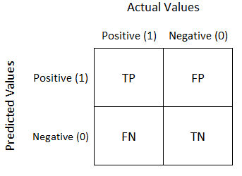
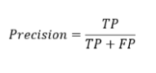
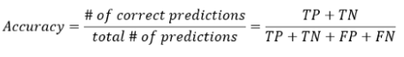
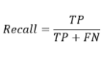
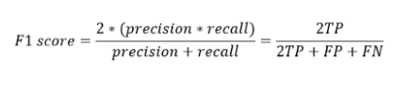
Confusion matrix
It is a summarized table to assess the performance of classification model.
Usually used for classification models.
Not only for evaluation but also for model monitoring & management.
Precision: (Positive predicted value)
Accuracy
Focus on 1st row
It answers, what proportion of the predicted positive identification was actually correct
Recall: (True positive rate/ Sensitivity/ Hit rate)
F1 score
It’s Measure of test’s accuracy
Harmonic mean of precision & Recall
Range in ( 0 – 1)
Focus on 1st Column
It answers, what proportion of actual positives was identified correctly

Slide 36


The dataset used had irregularities in terms of timestamps. The Timestamps of the data recorded were not collected at consistently at equal intervals of time.
The datasets were lacking in the number of rows present for each variety eg. There were not enough amount of failure codes to be used for training the data.
Challenges Faced

Slide 37
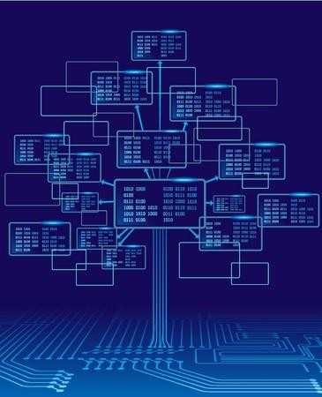
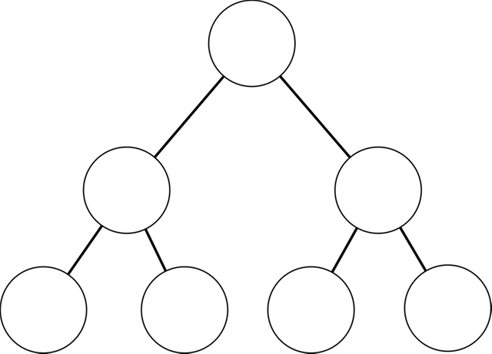

Decision Tree
A decision tree can be used to visually represent the “decisions”, or if- then rules, that are used to generate predictions.
We go through each yes
or no question,
or decision node, in the tree and will move down the tree accordingly, until we reach our final predictions.
Hungry
Want to Cook
Sleepy
Take Out
C ook
T.V
Sleep
Root Node
Leaf Node

